Slide 1

^{Lariat’s Car Rental Analysis}
Prepared for Lariat Rent-A-Car
Prepared by Susmita Katha, DA

Slide 2
Background
A national rental car company called Lariat,
wants to make data-driven decisions about the vehicles that they purchase for their national fleet.

Slide 3

Goals
The primary goal is to minimize costs and maximize the revenue to increase overall profitability of the rental car fleet.

Slide 4
The Data
Lariat rental car company has provided raw data in the following four Excel workbooks-
    car_id_mapping
    car_costs
    car_revenue
    branch_location

Slide 5
Key Findings
Baseline
Total Number of Cars 4000
Annual Cost $33,076,689
Annual Revenue $52,834,665
Total Profit $19,757,976
Profit Margin 37%

Slide 6
Model I
Strategy 1: Increase in Car Rent Quantity
Strategy 2: Raise of Car Rent Price
Strategy 3: Combine two strategies together

Slide 7
Model I Scenario
Rent Quantity
Increase 20%
Rent Price Raise 10%

Slide 8
Model II
Strategy 1: Buy Most Profitable Cars
Strategy 2: Sell Least Profitable Cars
Strategy 3: Combine Two Strategies

Slide 9
Model II Scenario
Car Purchased 20%
Car Sold 20%

Slide 10
Recommendations
Consider growing rental quantity or raising rent of car. Both can increase profit.
Selling non-profitable and adding most profitable cars provide significant value to revenue.
It's predictable that together they will make the most profit.

Slide 11
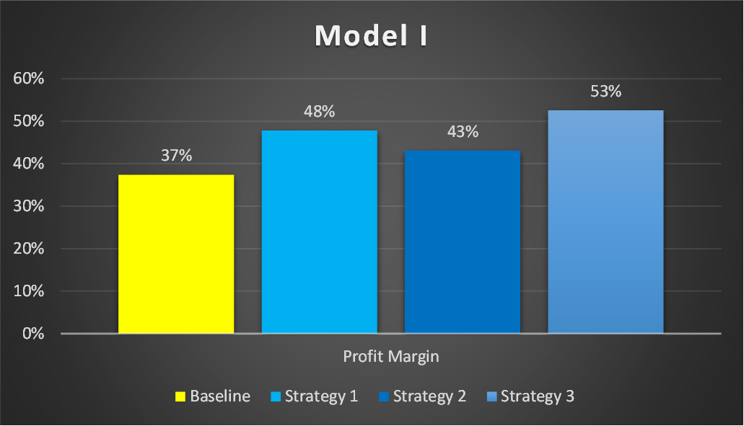
Call on action
The charts below show the effects on profits after reducing annual rentals and increasing revenue for Lariat Car Rental Company.

Slide 12

Next Steps
There is other information that the company management may find useful, such as company profitability in different states or branch locations. That is out of scope of this project, but it could be considered as a next step for analyzing profit models.
Please contact the DA consultant for your future analytics needs!

Slide 13


